Slide 1


Programming Language Concepts Tutorials
Become a Programming Languages Designer
Supervised by Dr. Kenny Zhu
TAs: Essam Abdelghany

Slide 2
Pop Quiz
Reminder in tutorials we recap on lecture, discuss assignments, discuss project or programming and solve practice problems.

Slide 3

Pop Quiz
0) In logic programming……….
Computation and deduction are unified
If no rule can be applied to reach the facts or premises, then the given claim (query) is certainly false
For loops and if-conditions are explicitly present
Computations possible are as powerful as any other language
Rules are chosen based on matching with the query and performing assignments.

Slide 4
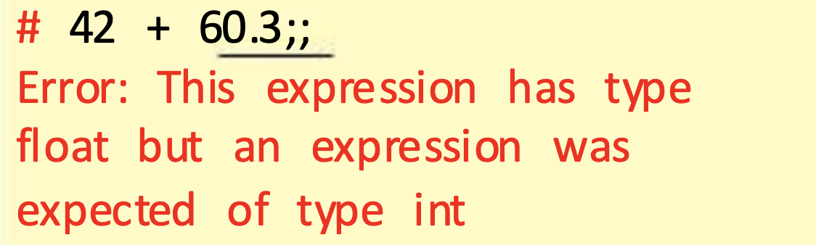
Pop Quiz
1) Features that OCaml supports………..
Statically typed
Strongly typed
Type inference
Both interpretation and compilation via ocaml and ocamlopt

Slide 5
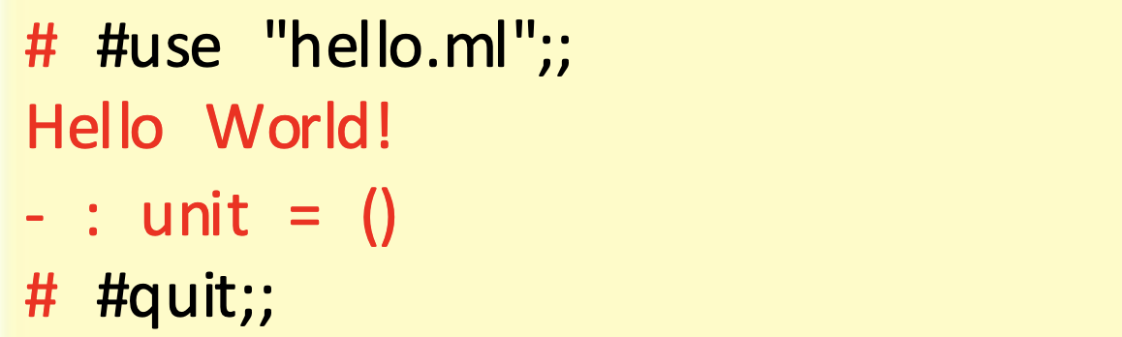
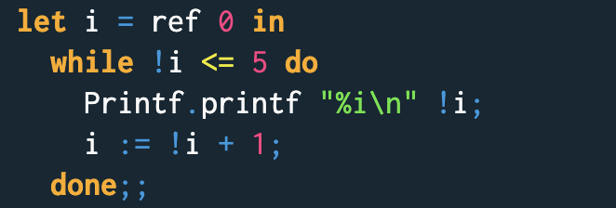
Pop Quiz
2) True facts about OCaml………..
Double semi-colon is used to submit code to the REPL
Single semi-colon is used for sequencing of imperative statements
Comments start with #
# is for directives for the REPL (e.g., #use)

Slide 6
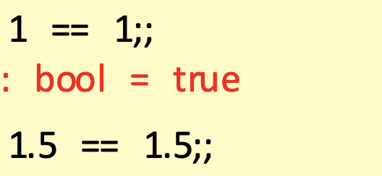
Pop Quiz
3) In comparing two data structures with OCaml……….
Better to use = and <> (structural equality)
Better to use == and != (physical equality)
Better to loop on data structure elements then = and <>
Impossible as its based on lambda calculus

Slide 7
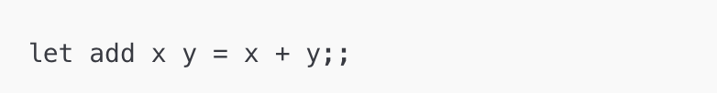
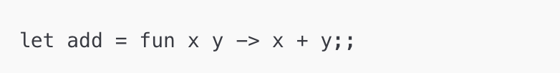
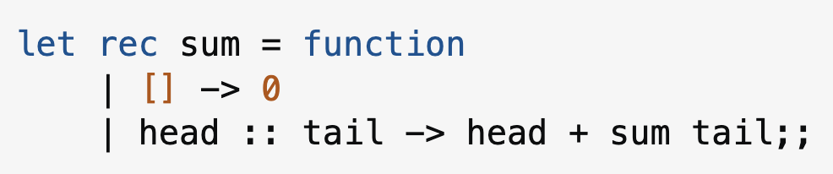
Pop Quiz
4) Functions in OCaml……….
Support explicit pattern matching unlike other languages
Can be named or anonymous
Require the rec keyword to be recursive
All of the above
Note that only `function` allows pattern matching…

Slide 8
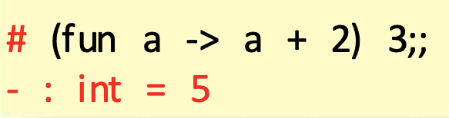
Pop Quiz
5) In OCaml……….
Let expression is always equivalent to function call
Let-in expression is always equivalent to function call
There is support for tail-call optimization
Lists and tuples are supported

Slide 9
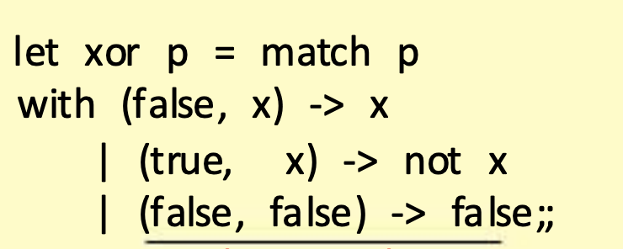
Pop Quiz
6) In OCaml……….
List.iter and List.map help apply a function to each element in list
List.fold_right and List.fold_left can help aggregate list elements
Compiler tells you when a match case is missing or unused
Variable matches anything like wildcard in matching

Slide 10
Assignment Solution

Slide 11
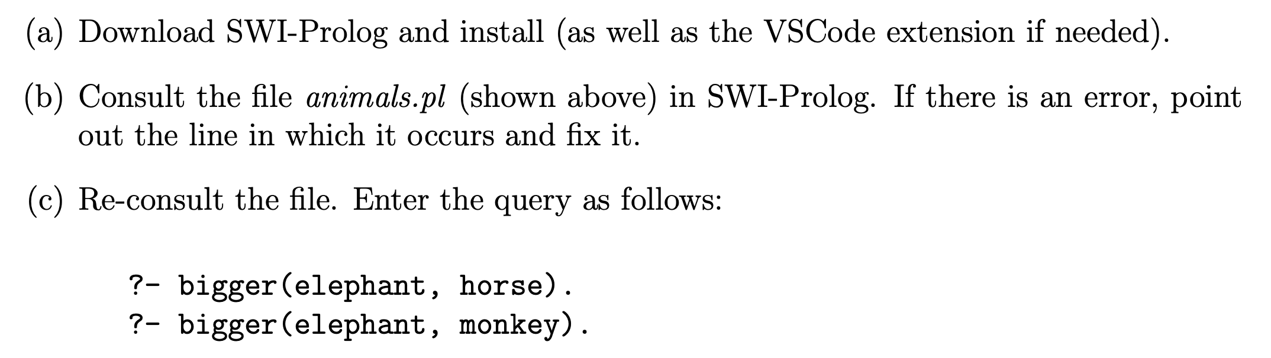
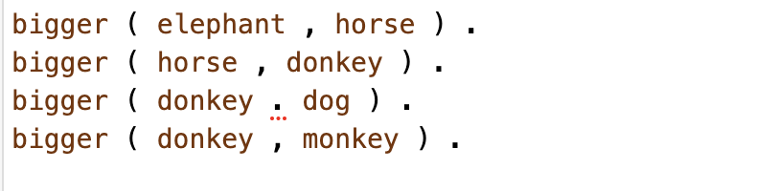
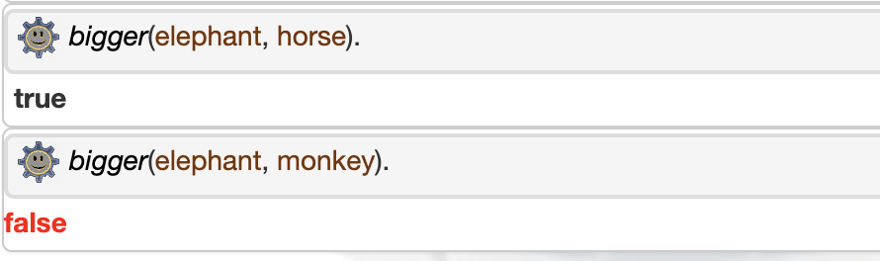
Assignment Solution
Error with the dot in third line…
We don’t have the transitivity relation as expected…

Slide 12
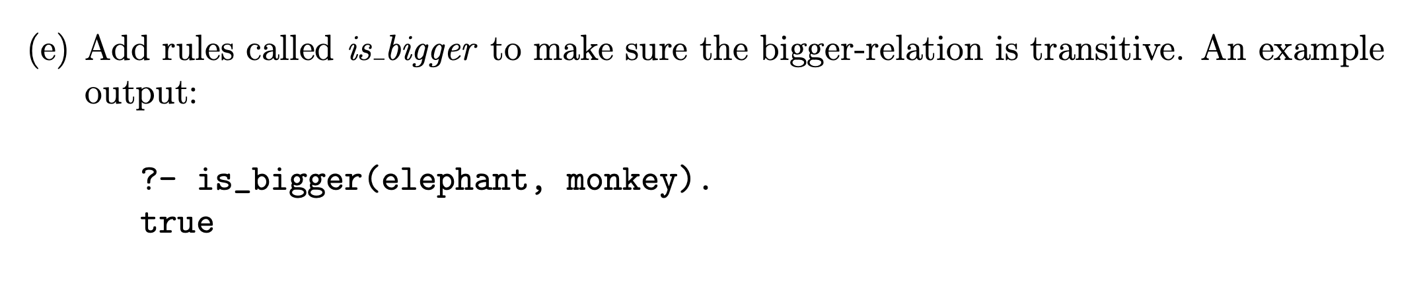
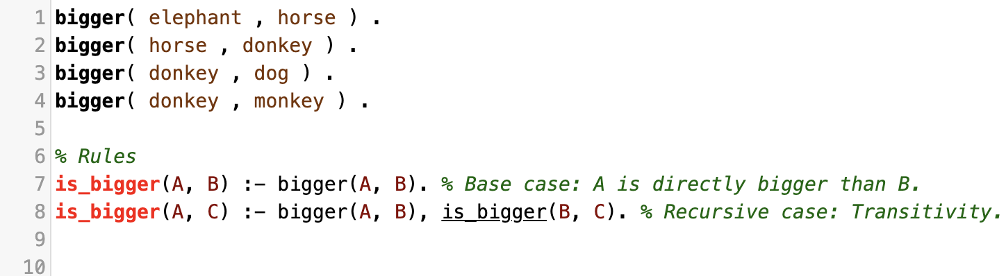
Assignment Solution
Need bigger(elephant, horse), bigger(horse, donkey), bigger(donkey, monkey)

Slide 13
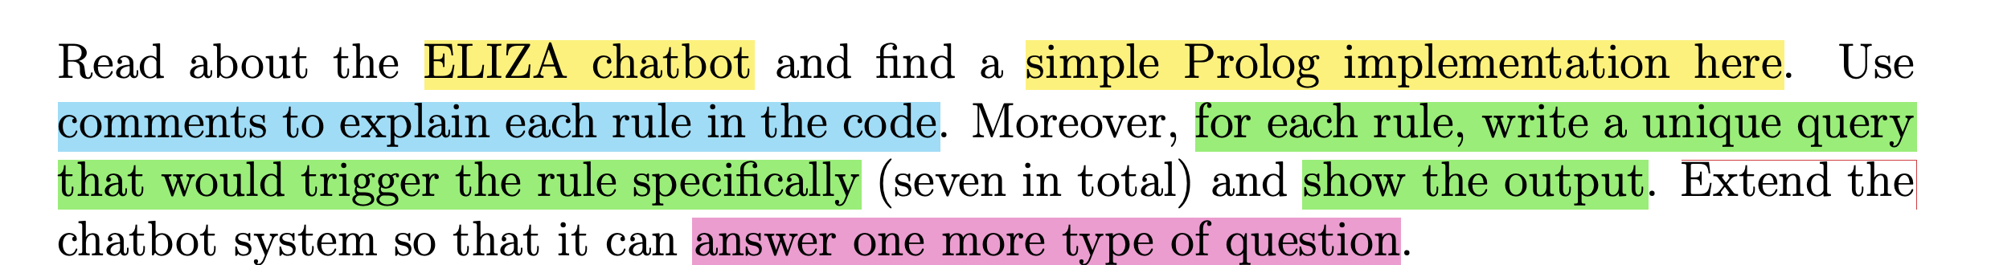
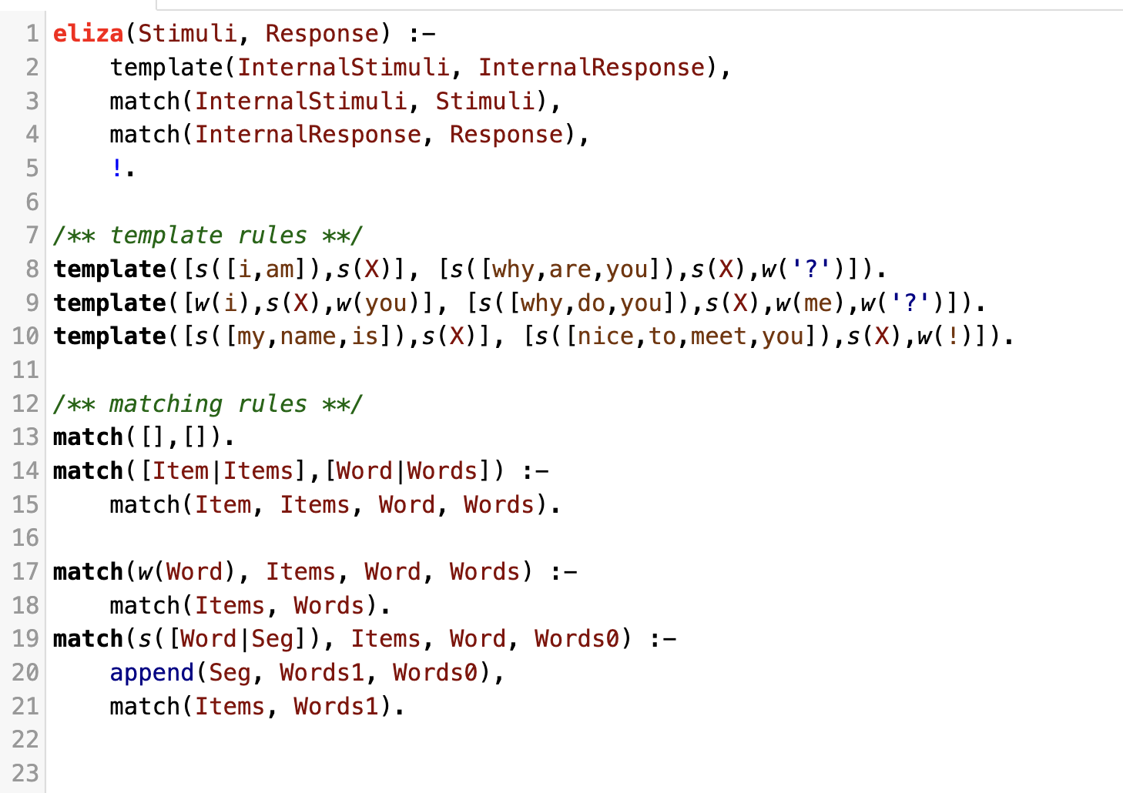
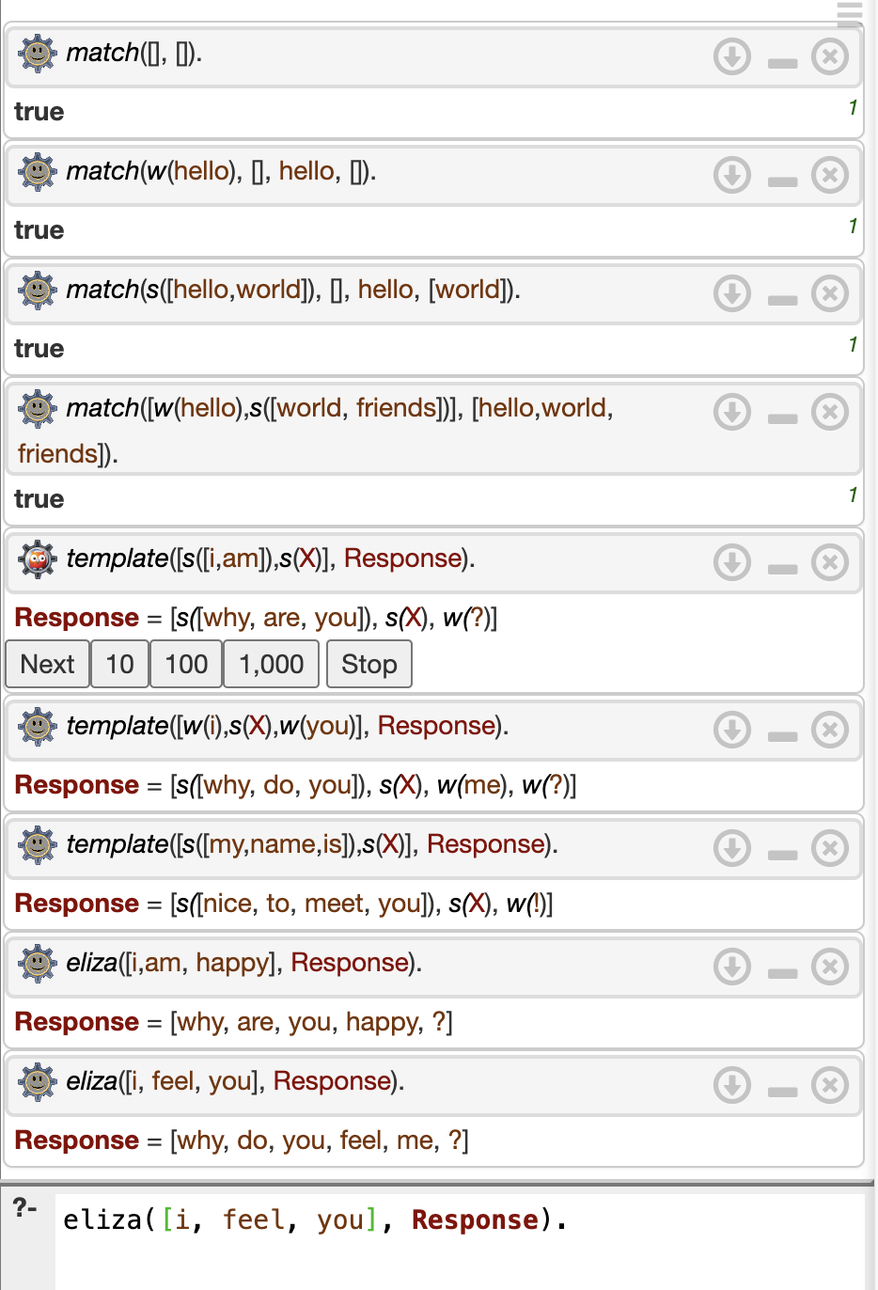
Assignment Solution

Slide 14
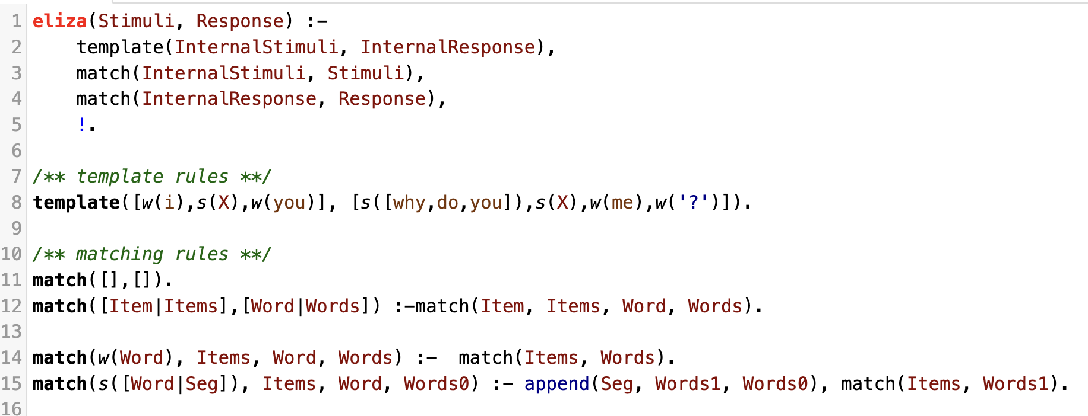
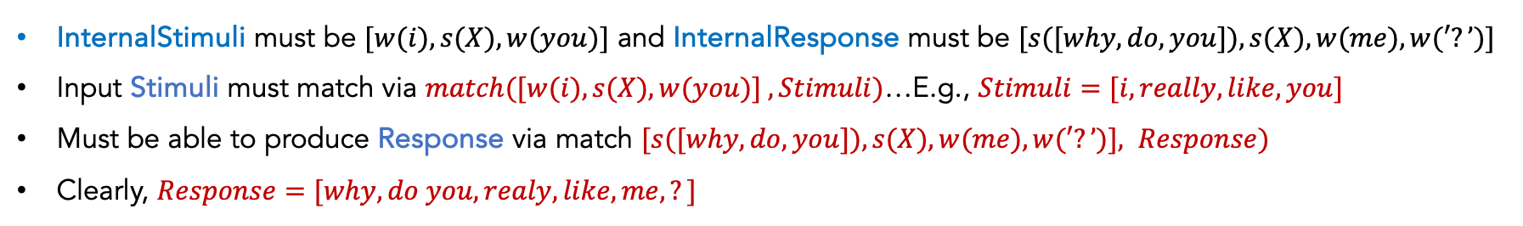
Assignment Solution
Segment is a subset of remaining words
Anything left of from such subset (Words1) matches rest of items.
S(X)
[w(you)]
really
[like, you]
[like, you]
[W(you)]
X=Word+Seg=really+Seg
InternalStimuli must be $[w(i),s(X),w(you)]$ and InternalResponse must be $[s([why,do,you]),s(X),w(me),w(′?’)]$
Input Stimuli must match via $match([w(i),s(X),w(you)] , Stimuli)$…E.g., $Stimuli=[i, really, like, you]$
Must be able to produce Response via match $[s([why,do,you]),s(X),w(me),w(′?’)], Response)$
Clearly, $Response=[why, do you, realy, like, me,?]$

Slide 15
Thank You

